Slide 1
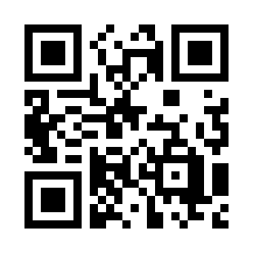
Introduction to Software Testing
https://bit.ly/30aRJhX

